Slide 1
The Battle of Neighbourhoods in Toronto – Capstone Project
Find the best place to open a gym in downtown Toronto

Slide 2
Table of contents:
Introduction
Data
Methodology
3.1 Exploratory data analysis
3.2 Clustering
Results and discusión
Conclusion

Slide 3
1. Introduction
Goal: to find out the best neighbourhoods in downtown Toronto to open a profitable gym venue.
Aimed to: entrepreneurs or business owners wanting to open their own gym business or grow their business in a profitable location where little or no competition exists today.

Slide 4
2. Data
The following data sources will be needed for this analysis:
Wikipedia page with the Neighbourhoods and postal codes of Toronto city (https://en.wikipedia.org/wiki/List_of_postal_codes_of_Canada:_M )
The geographical coordinates of each postal code through reading the CSV file (https://cocl.us/Geospatial_data) and transforming it into a Pandas data frame.
Explore and get the venues data using Foursquare API.

Slide 5
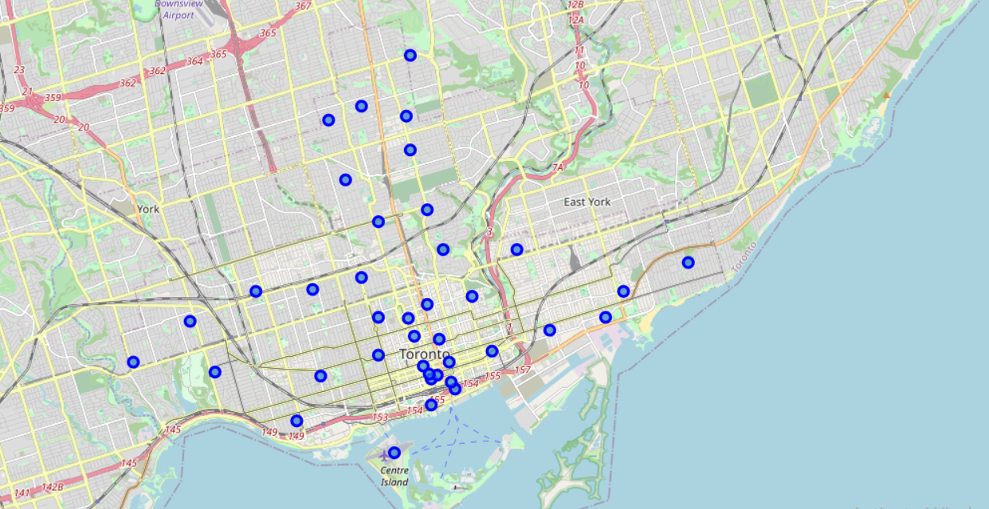
3. Methodology
3.1 Exploratory Data Analysis
First, we transform the data from the Wikipedia source, that is rename features, drop cells (those with Boroughs equal to ‘not assigned’) and group the data.
Then get each neighbourhood’s coordinates using the Geocoder package.
To explore the data, we use the Folium library that can create interactive maps of the area of our interest: downtown Toronto

Slide 6
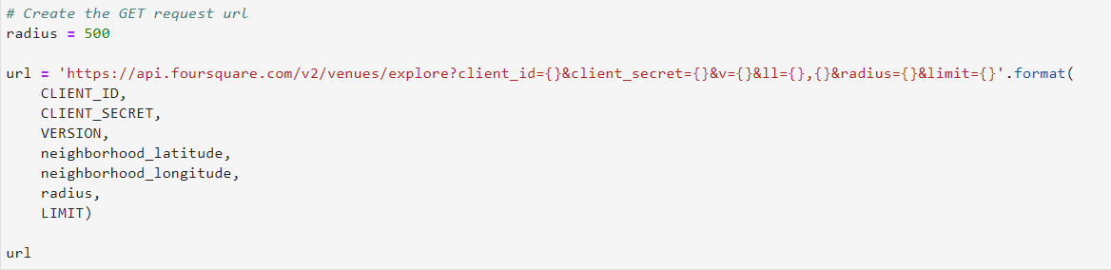
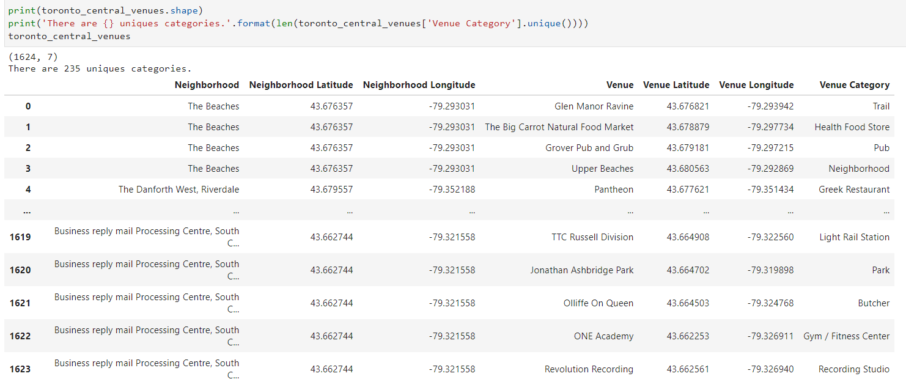
Next it is the moment to use the Foursquare API to extract the venues of each neighbourhood in downtown Toronto.
After some coding we get to know the number of unique categories of venues in downtown Toronto

Slide 7
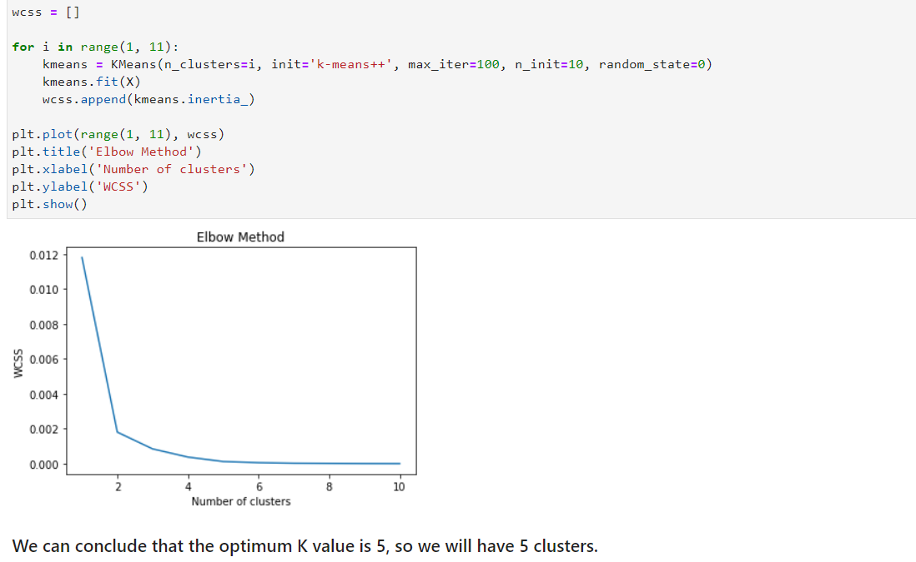
3.2 Clustering
To analyze which neighbourhood of downtown Toronto is more suitable to open a new gym, we use the K-Means clustering model: a type of unsupervised learning which is used when you have unlabeled data.
As we want to know which would be the optimal number of clusters, the best K, we will use the Elbow Method. It is an analytical approach that consists of training multiple models using different number of clusters and storing the value of inertia_property (wcss) every time.
The best K is 5, so we run the K-Means
clustering with this number.

Slide 8
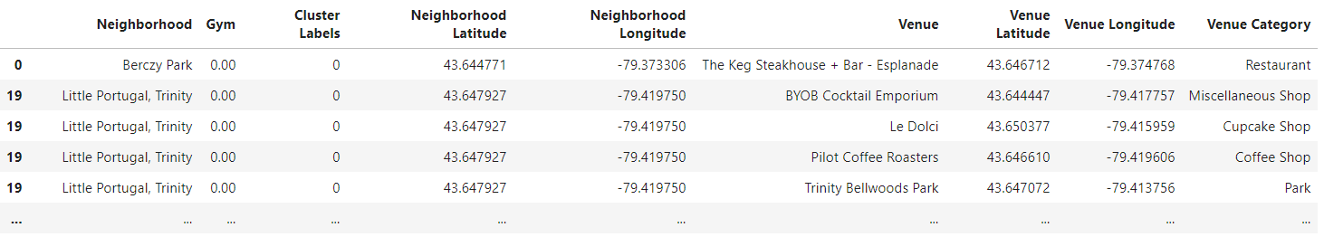
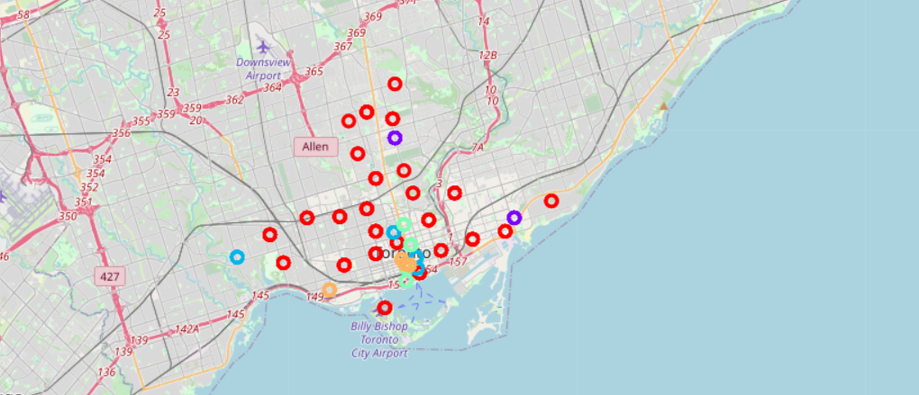
Finally we merge both data frames, the one with the venues of downtown Toronto and the othe with the clusters
And we plot the Folium map with the different clusters

Slide 9
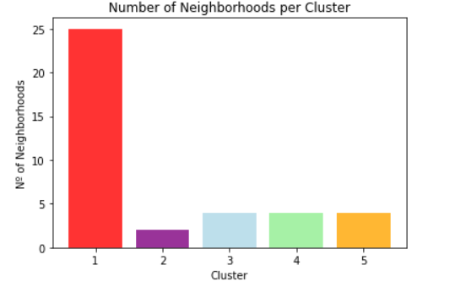
4. Results and discussion
We have a total of five clusters and we get to know how many neighbourhoods there are in each of them.
Then we make an analysis of each cluster and the average number of gym venues on them.:
Cluster 1 (red) is the bigger one in terms of number of neighbourhoods and there are no gym venues in this cluster.
Cluster 2 (purple) is the smallest cluster with only two neighbourhoods and has the highest average of gyms.
Cluster 3 (lightblue) encompasses 4 neighbourhoods and has a total of 6 gyms.
Cluster 4 (lightgreen) has 4 neighbourhoods as well but a lower average of gym venues than cluster 3.
Cluster 5 (Orange) comprises also 4 neighbourhoods and has the second higher average number of gyms after cluster 2.

Slide 10
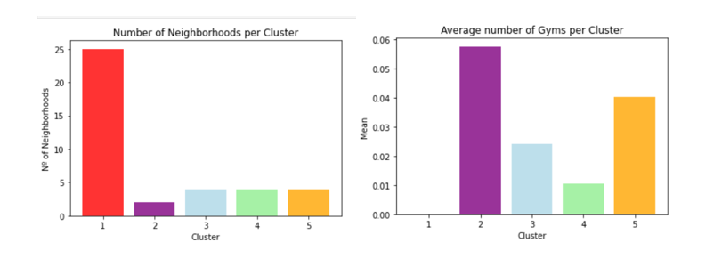
4. Conclusion
Most of the gym venues in downtown Toronto city are in cluster2 represented by the purple colour. The Neighbourhoods located in Central Toronto that have the highest average of gyms are Davisville, India Bazaar and The Beaches West.
Even though cluster1 has the larger number of Neighbourhoods (25), there is no gym within it, so this is a great opportunity to open a new one, with no competition. So Neighbourhoods like The Beaches, Kensington Market, Chinatown, Grange Park, Regent Park, Harbourfront would be the ideal location for the opening of a gym.
We must also point out that there is at least one drawback in this analysis and it is the fact of only using the data that come from Foursqare API, without looking for richer information like population of different Neighbourhoods to have one more element to make the decision.

